Slide 1
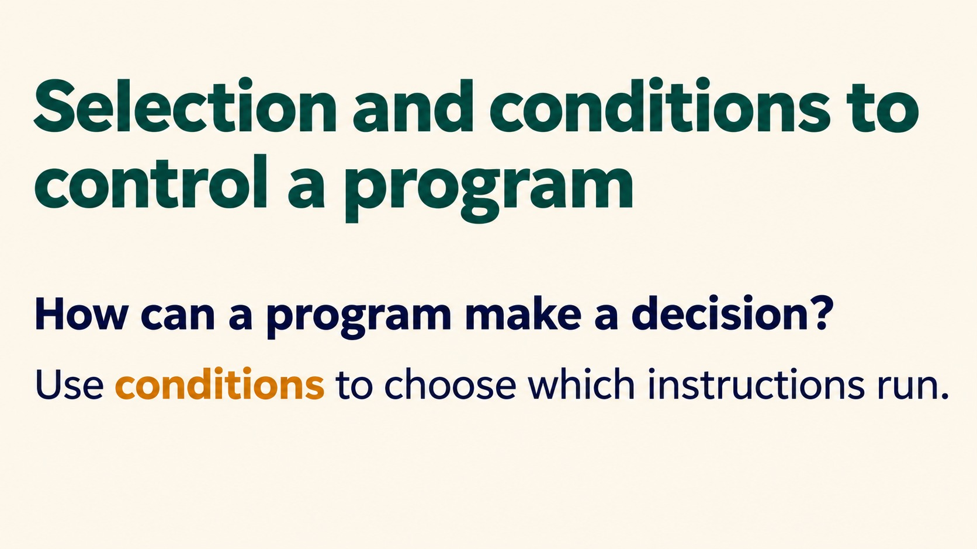
Notes:
Selection and conditions to control a program
How can a program make a decision?
Use conditions to choose which instructions run.
Source: Pearson Edexcel International GCSE (9-1) Computer Science, Unit 2, Develop Code, printed pages 38-42. Teaching examples adapted for Python. Slide artwork generated with OpenAI image generation.

Slide 2
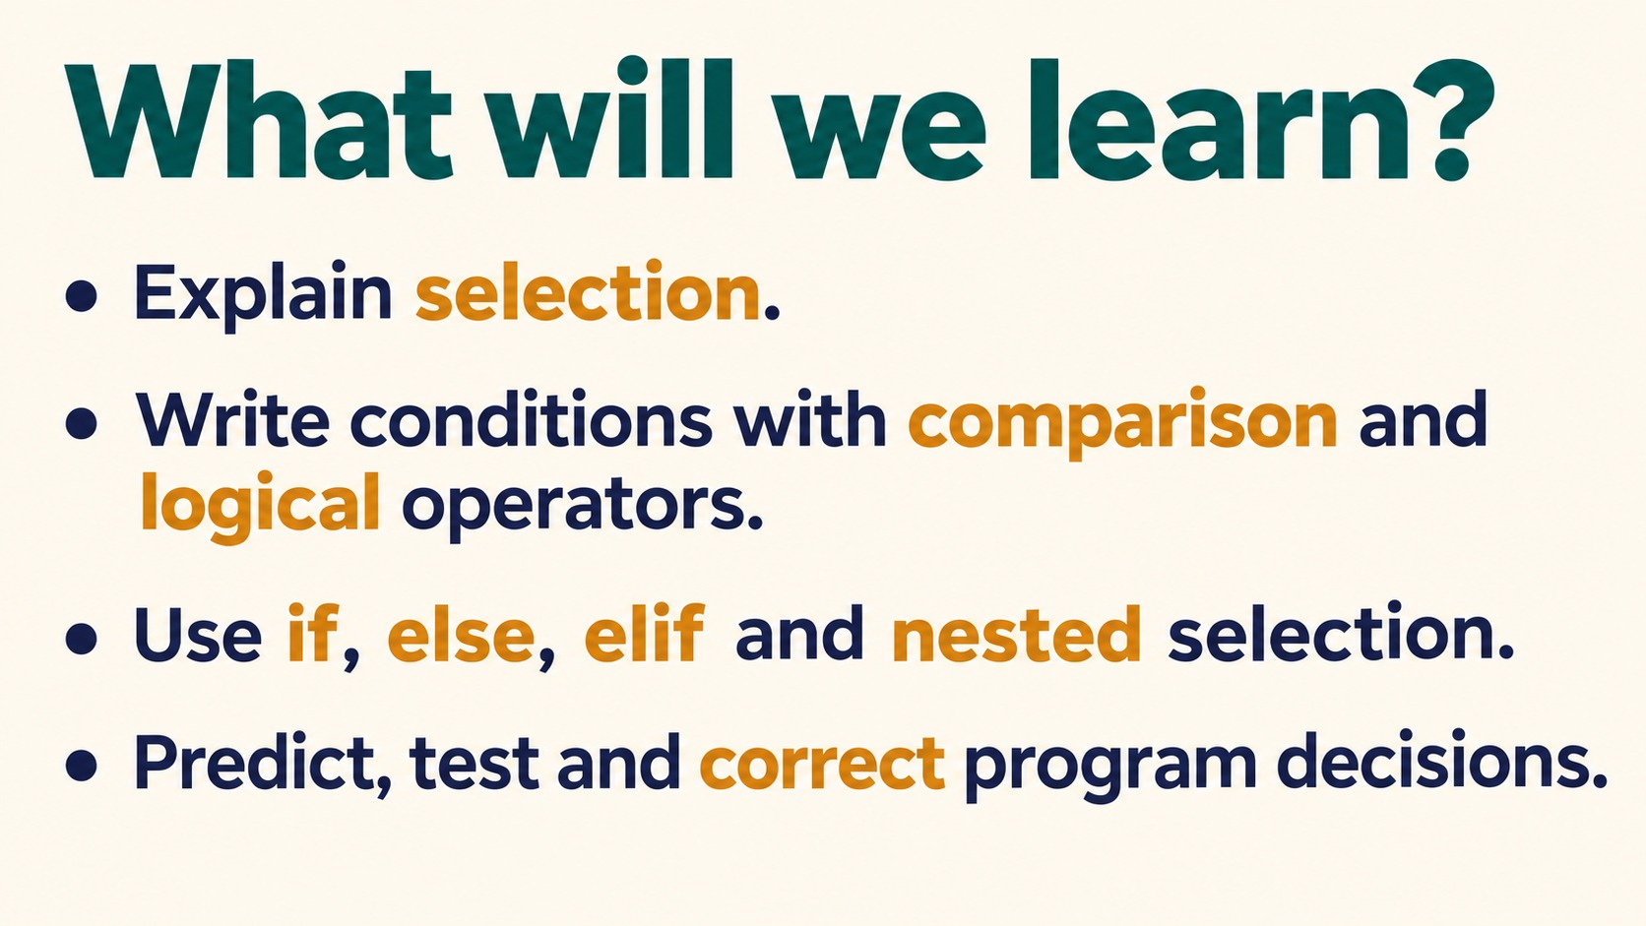
Notes:
What will we learn?
Explain selection.
Write conditions with comparison and logical operators.
Use if, else, elif and nested selection.
Predict, test and correct program decisions.
Source: Pearson Edexcel International GCSE (9-1) Computer Science, Unit 2, Develop Code, printed pages 38-42. Teaching examples adapted for Python. Slide artwork generated with OpenAI image generation.

Slide 3
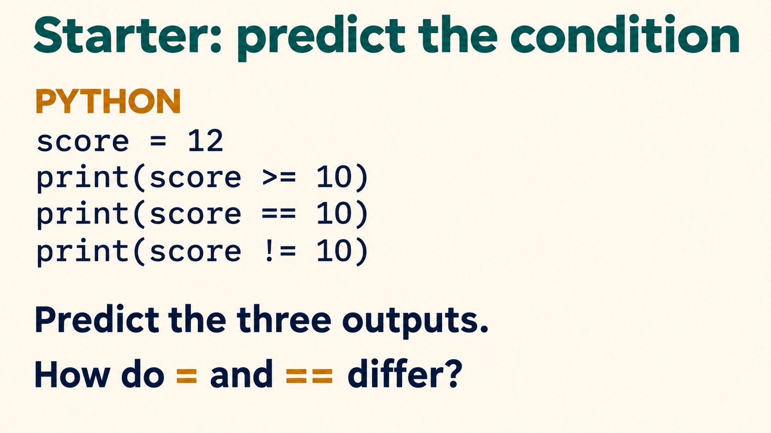
Notes:
Starter: predict the condition
PYTHON
score = 12
print(score >= 10)
print(score == 10)
print(score != 10)
Predict the three outputs.
How do = and == differ?
Answers: True, False, True. = assigns a value; == compares values.
Source: Pearson Edexcel International GCSE (9-1) Computer Science, Unit 2, Develop Code, printed pages 38-42. Teaching examples adapted for Python. Slide artwork generated with OpenAI image generation.

Slide 4
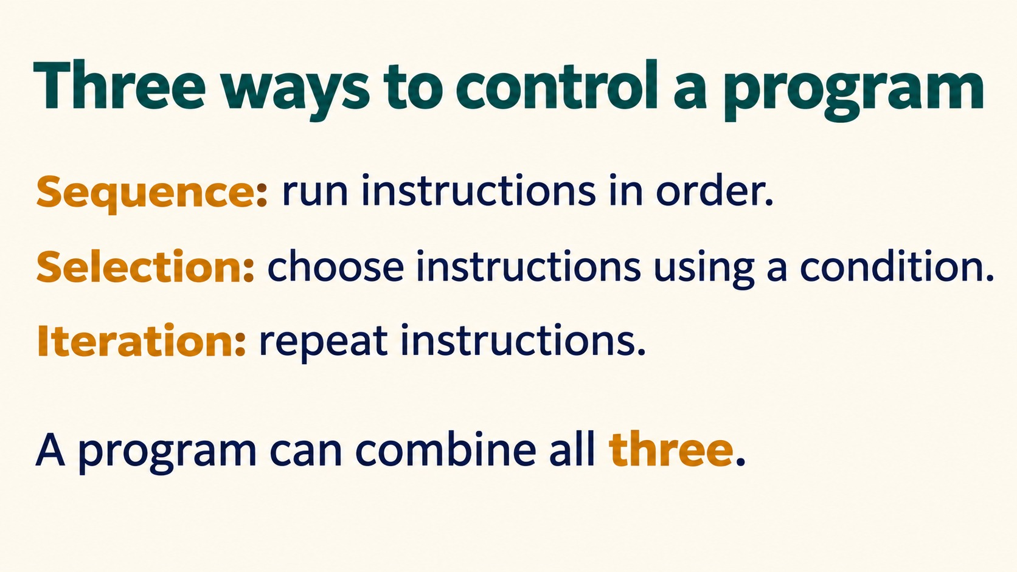
Notes:
Three ways to control a program
Sequence: run instructions in order.
Selection: choose instructions using a condition.
Iteration: repeat instructions.
A program can combine all three.
Source: Pearson Edexcel International GCSE (9-1) Computer Science, Unit 2, Develop Code, printed pages 38-42. Teaching examples adapted for Python. Slide artwork generated with OpenAI image generation.

Slide 5
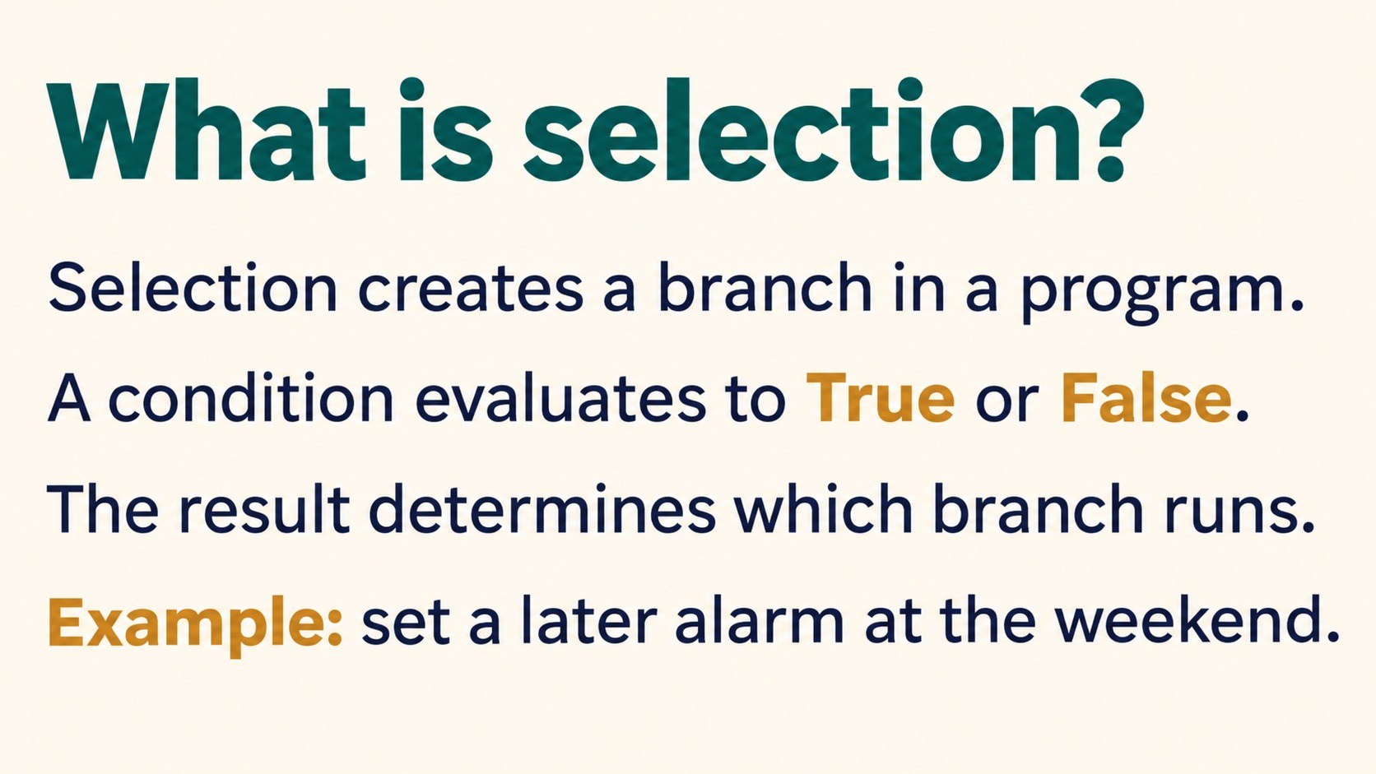
Notes:
What is selection?
Selection creates a branch in a program.
A condition evaluates to True or False.
The result determines which branch runs.
Example: set a later alarm at the weekend.
Source: Pearson Edexcel International GCSE (9-1) Computer Science, Unit 2, Develop Code, printed pages 38-42. Teaching examples adapted for Python. Slide artwork generated with OpenAI image generation.

Slide 6
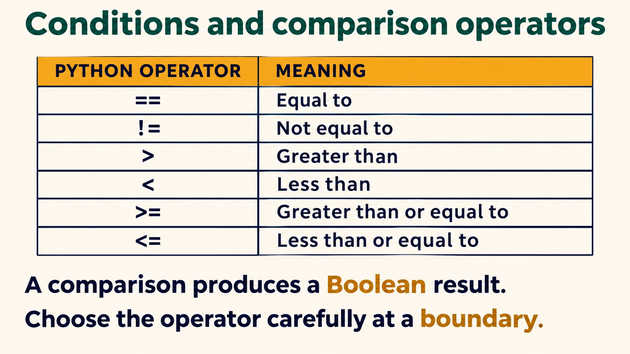
Notes:
Conditions and comparison operators
PYTHON OPERATOR MEANING
== Equal to
!= Not equal to
> Greater than
< Less than
>= Greater than or equal to
<= Less than or equal to
A comparison produces a Boolean result.
Choose the operator carefully at a boundary.
Source: Pearson Edexcel International GCSE (9-1) Computer Science, Unit 2, Develop Code, printed pages 38-42. Teaching examples adapted for Python. Slide artwork generated with OpenAI image generation.

Slide 7
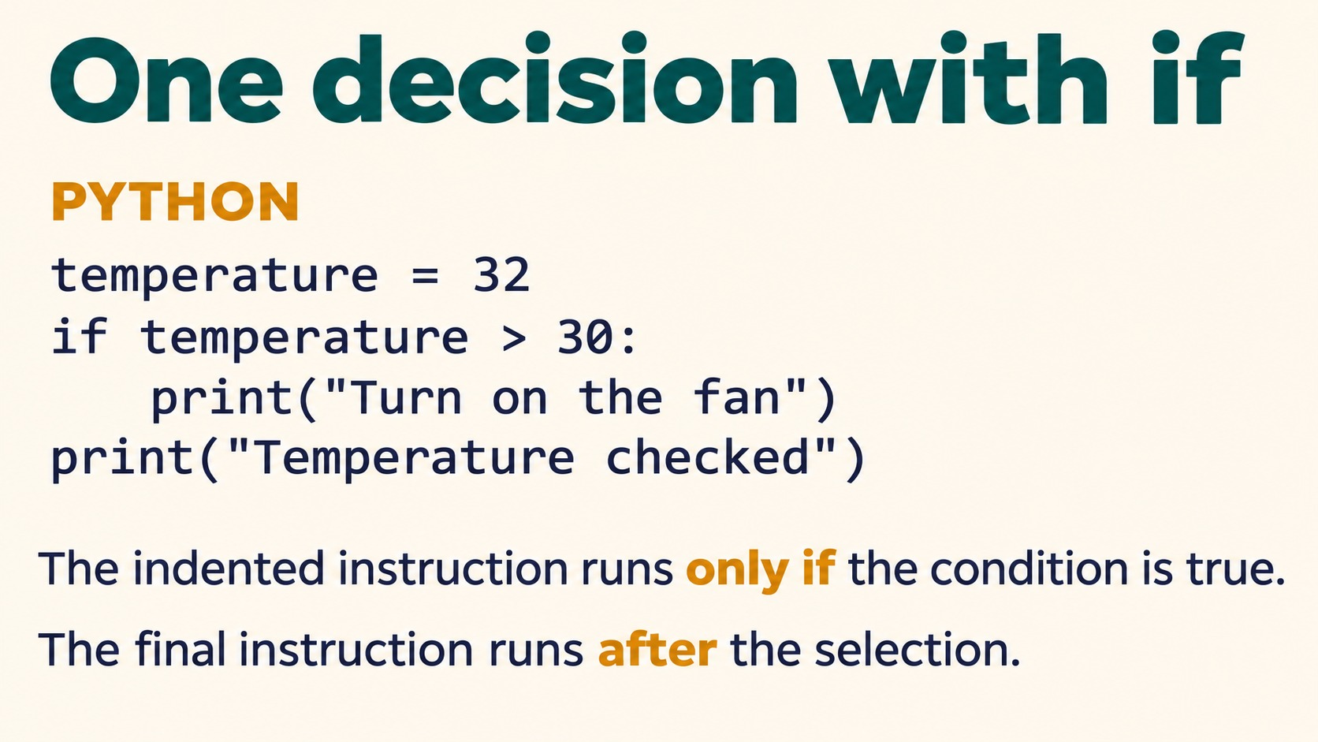
Notes:
One decision with if
PYTHON
temperature = 32
if temperature > 30:
print("Turn on the fan")
print("Temperature checked")
The indented instruction runs only if the condition is true.
The final instruction runs after the selection.
Source: Pearson Edexcel International GCSE (9-1) Computer Science, Unit 2, Develop Code, printed pages 38-42. Teaching examples adapted for Python. Slide artwork generated with OpenAI image generation.

Slide 8
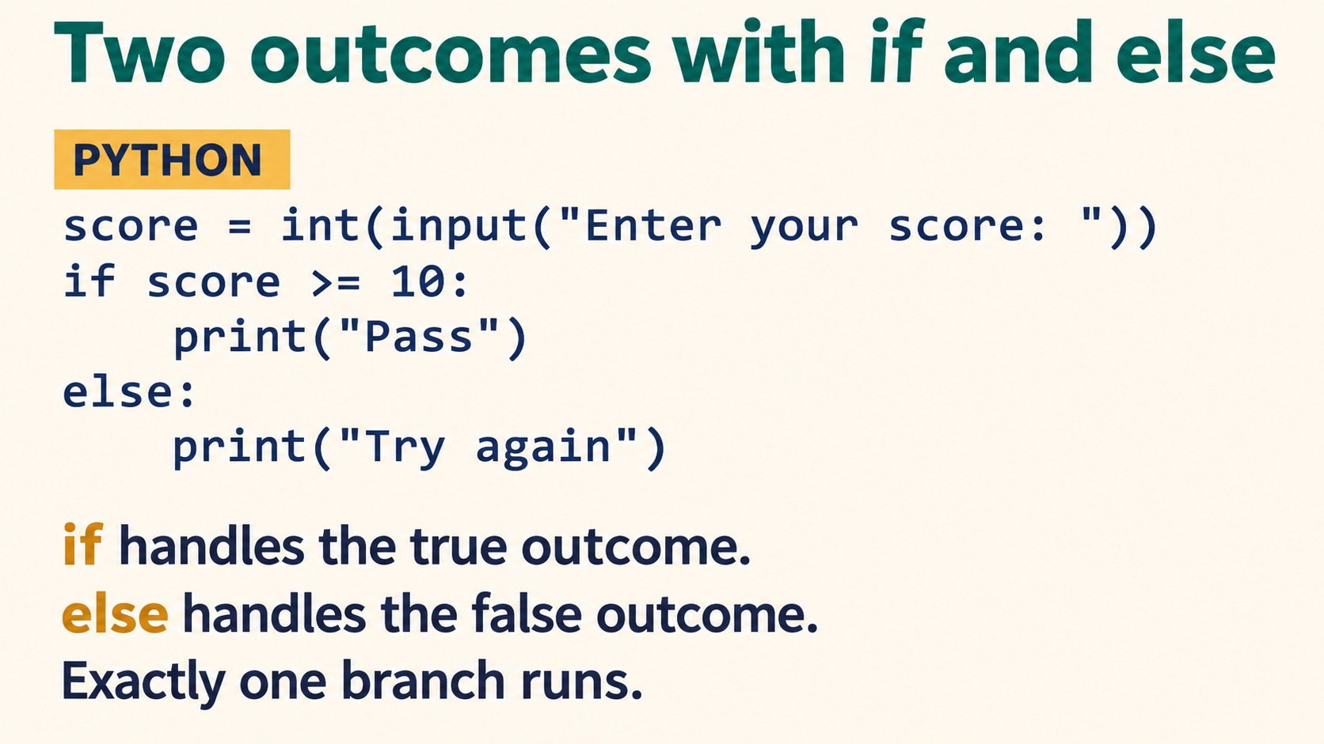
Notes:
Two outcomes with if and else
PYTHON
score = int(input("Enter your score: "))
if score >= 10:
print("Pass")
else:
print("Try again")
if handles the true outcome.
else handles the false outcome.
Exactly one branch runs.
Source: Pearson Edexcel International GCSE (9-1) Computer Science, Unit 2, Develop Code, printed pages 38-42. Teaching examples adapted for Python. Slide artwork generated with OpenAI image generation.

Slide 9
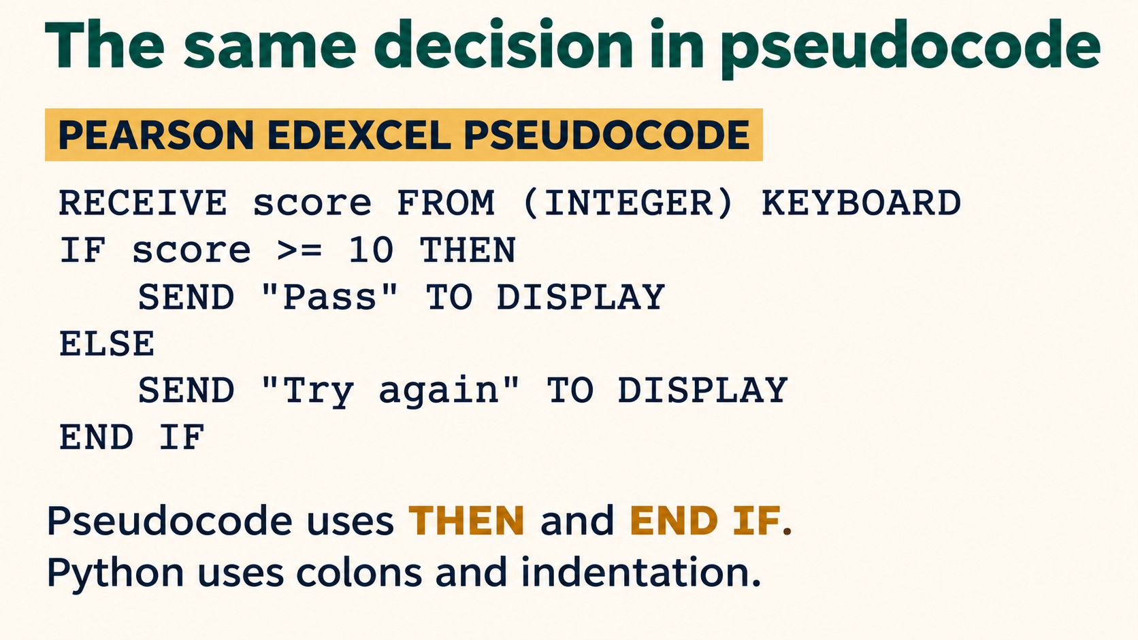
Notes:
The same decision in pseudocode
PEARSON EDEXCEL PSEUDOCODE
RECEIVE score FROM (INTEGER) KEYBOARD
IF score >= 10 THEN
SEND "Pass" TO DISPLAY
ELSE
SEND "Try again" TO DISPLAY
END IF
Pseudocode uses THEN and END IF.
Python uses colons and indentation.
Source: Pearson Edexcel International GCSE (9-1) Computer Science, Unit 2, Develop Code, printed pages 38-42. Teaching examples adapted for Python. Slide artwork generated with OpenAI image generation.

Slide 10
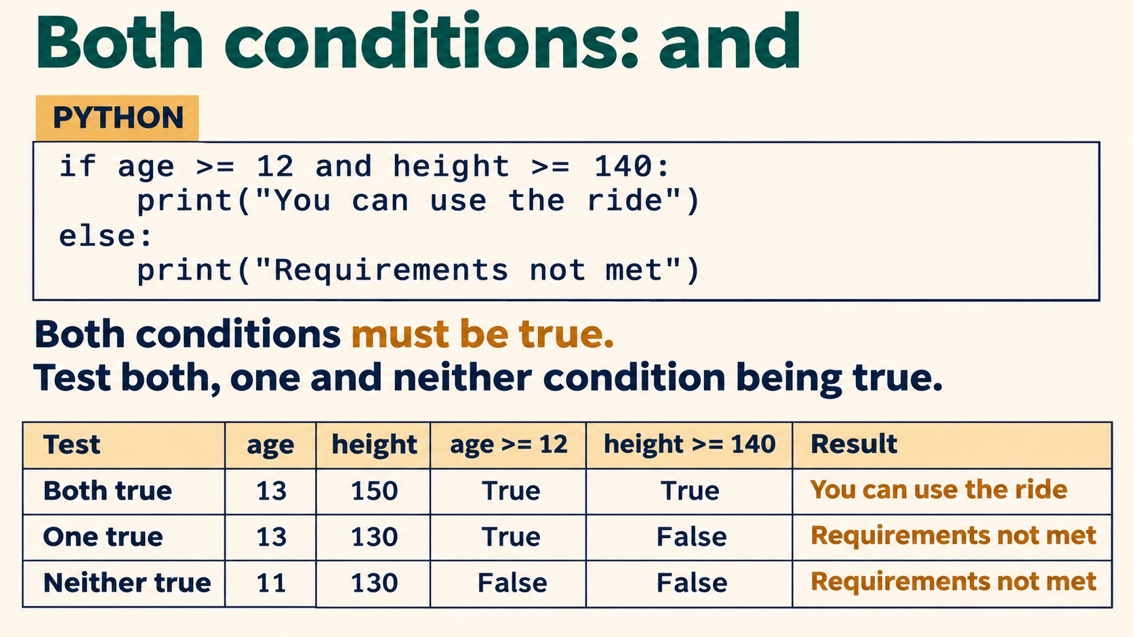
Notes:
Both conditions: and
PYTHON
if age >= 12 and height >= 140:
print("You can use the ride")
else:
print("Requirements not met")
Both conditions must be true.
Test both, one and neither condition being true.
Assume age and height have already been entered as numbers.
Source: Pearson Edexcel International GCSE (9-1) Computer Science, Unit 2, Develop Code, printed pages 38-42. Teaching examples adapted for Python. Slide artwork generated with OpenAI image generation.

Slide 11
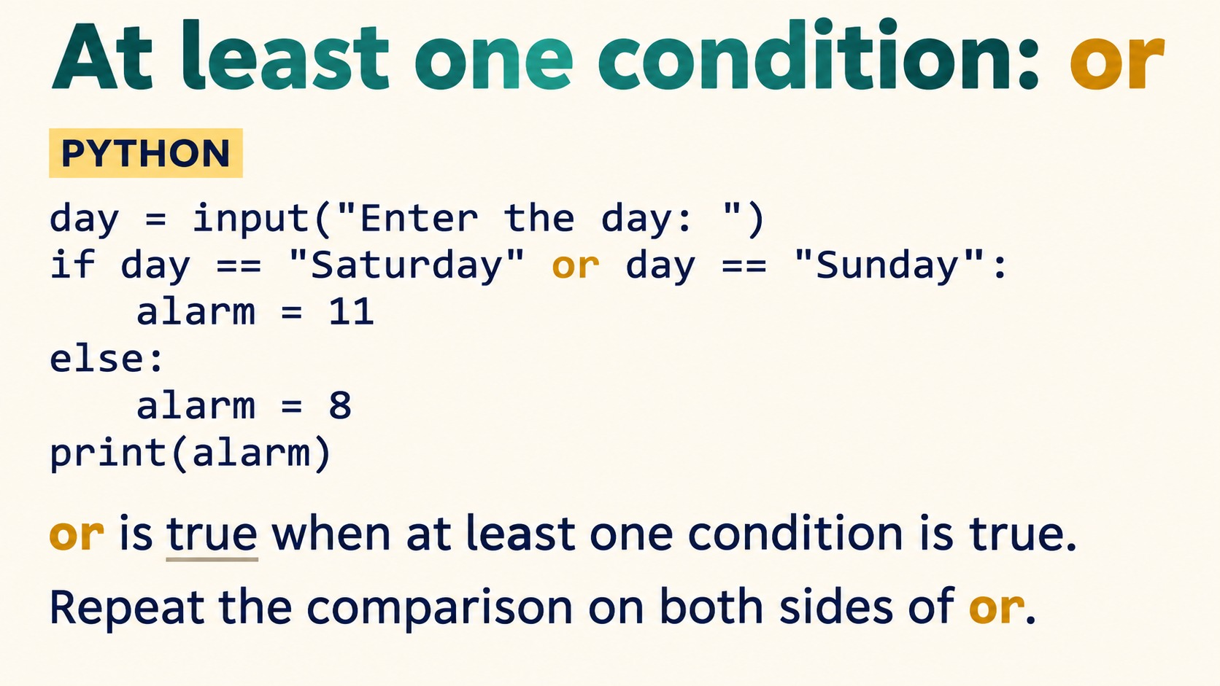
Notes:
At least one condition: or
PYTHON
day = input("Enter the day: ")
if day == "Saturday" or day == "Sunday":
alarm = 11
else:
alarm = 8
print(alarm)
or is true when at least one condition is true.
Repeat the comparison on both sides of or.
Source: Pearson Edexcel International GCSE (9-1) Computer Science, Unit 2, Develop Code, printed pages 38-42. Teaching examples adapted for Python. Slide artwork generated with OpenAI image generation.

Slide 12
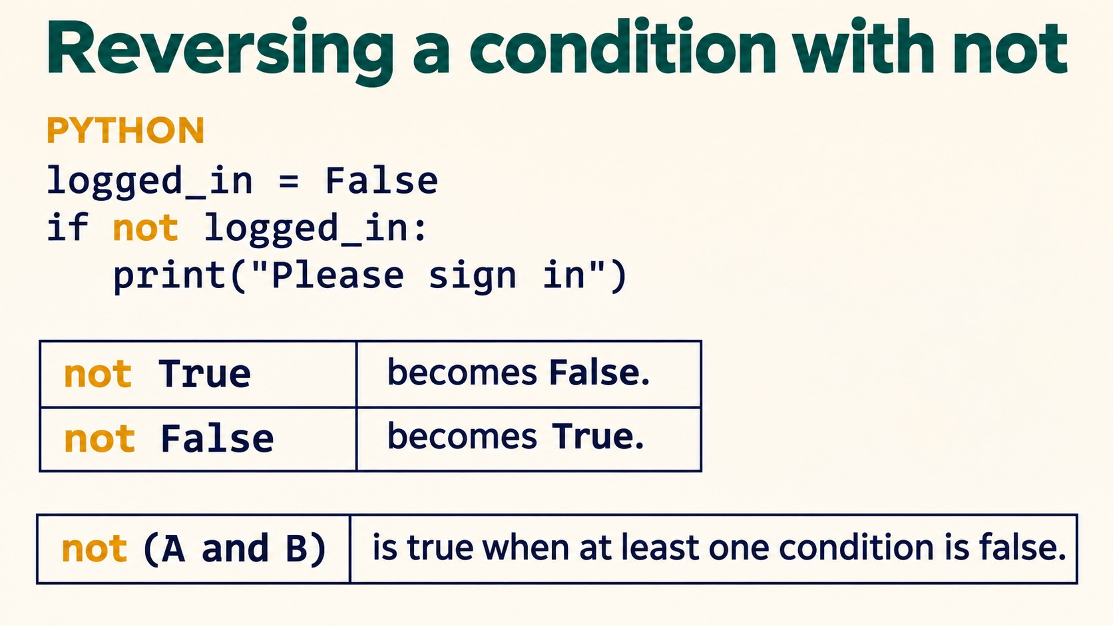
Notes:
Reversing a condition with not
PYTHON
logged_in = False
if not logged_in:
print("Please sign in")
not True becomes False.
not False becomes True.
not (A and B) is true when at least one condition is false.
Source: Pearson Edexcel International GCSE (9-1) Computer Science, Unit 2, Develop Code, printed pages 38-42. Teaching examples adapted for Python. Slide artwork generated with OpenAI image generation.

Slide 13
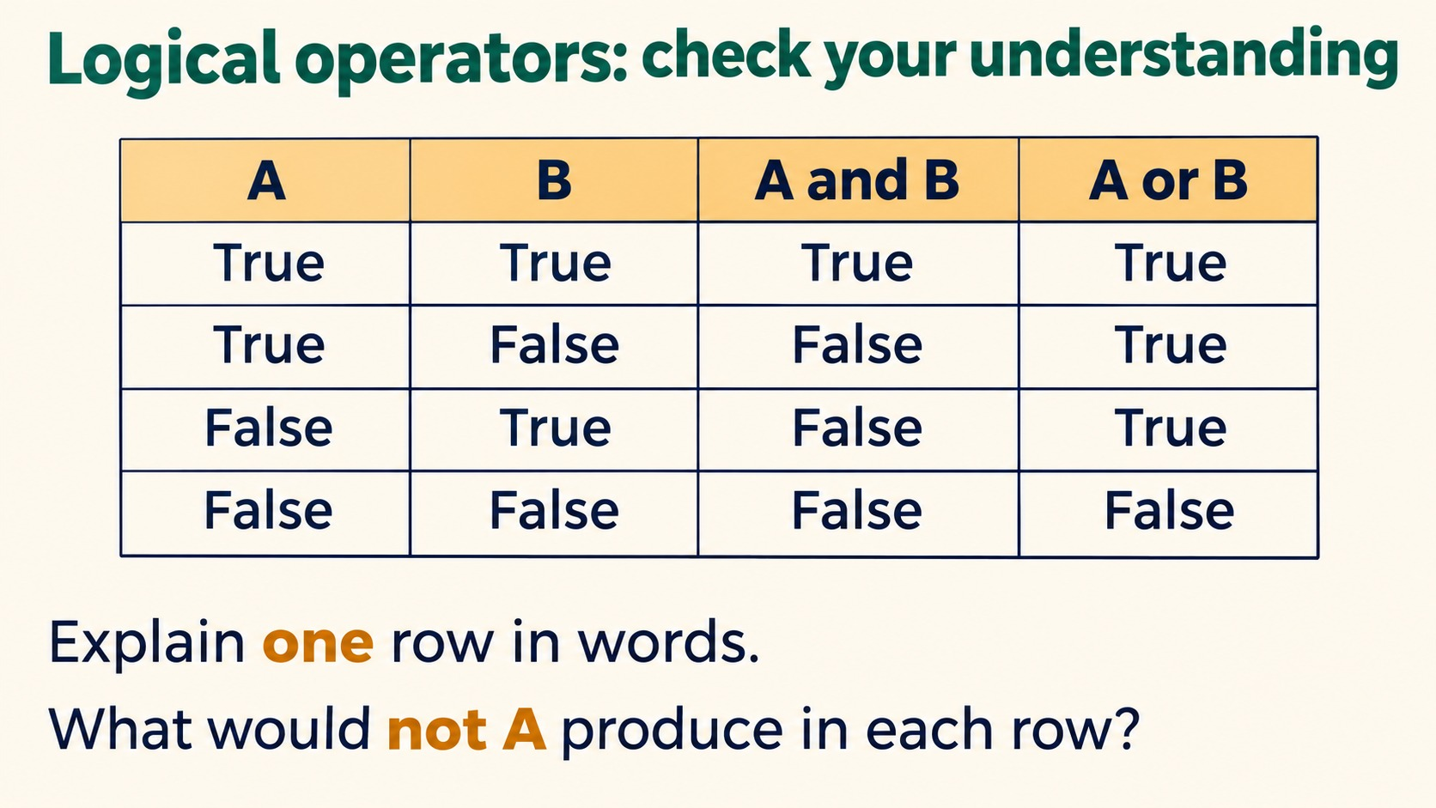
Notes:
Logical operators: check your understanding
A B A and B A or B
True True True True
True False False True
False True False True
False False False False
Explain one row in words.
What would not A produce in each row?
Source: Pearson Edexcel International GCSE (9-1) Computer Science, Unit 2, Develop Code, printed pages 38-42. Teaching examples adapted for Python. Slide artwork generated with OpenAI image generation.

Slide 14
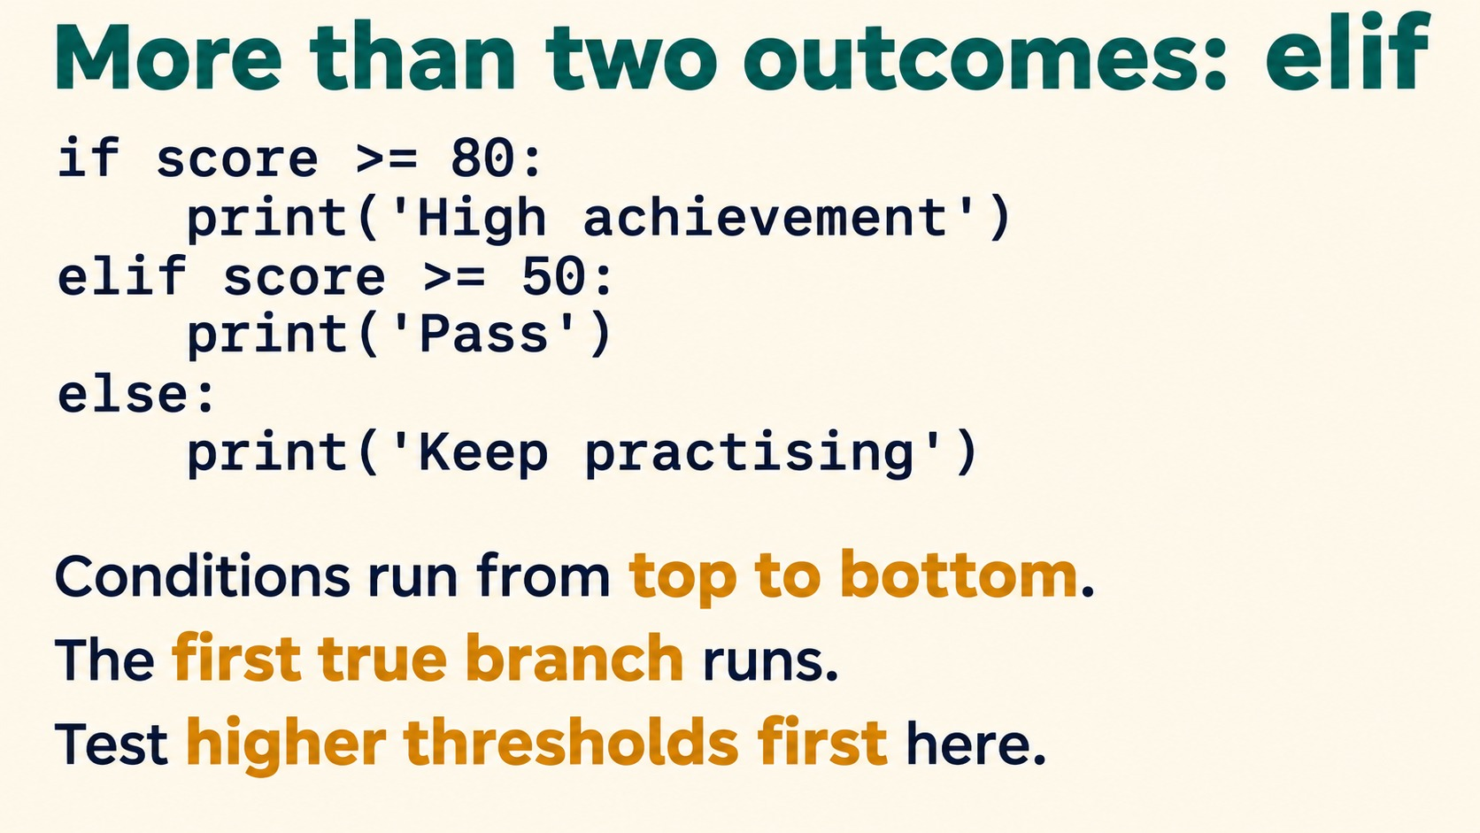
Notes:
More than two outcomes: elif
PYTHON
if score >= 80:
print("High achievement")
elif score >= 50:
print("Pass")
else:
print("Keep practising")
Conditions run from top to bottom.
The first true branch runs.
Test higher thresholds first here.
Source: Pearson Edexcel International GCSE (9-1) Computer Science, Unit 2, Develop Code, printed pages 38-42. Teaching examples adapted for Python. Slide artwork generated with OpenAI image generation.

Slide 15
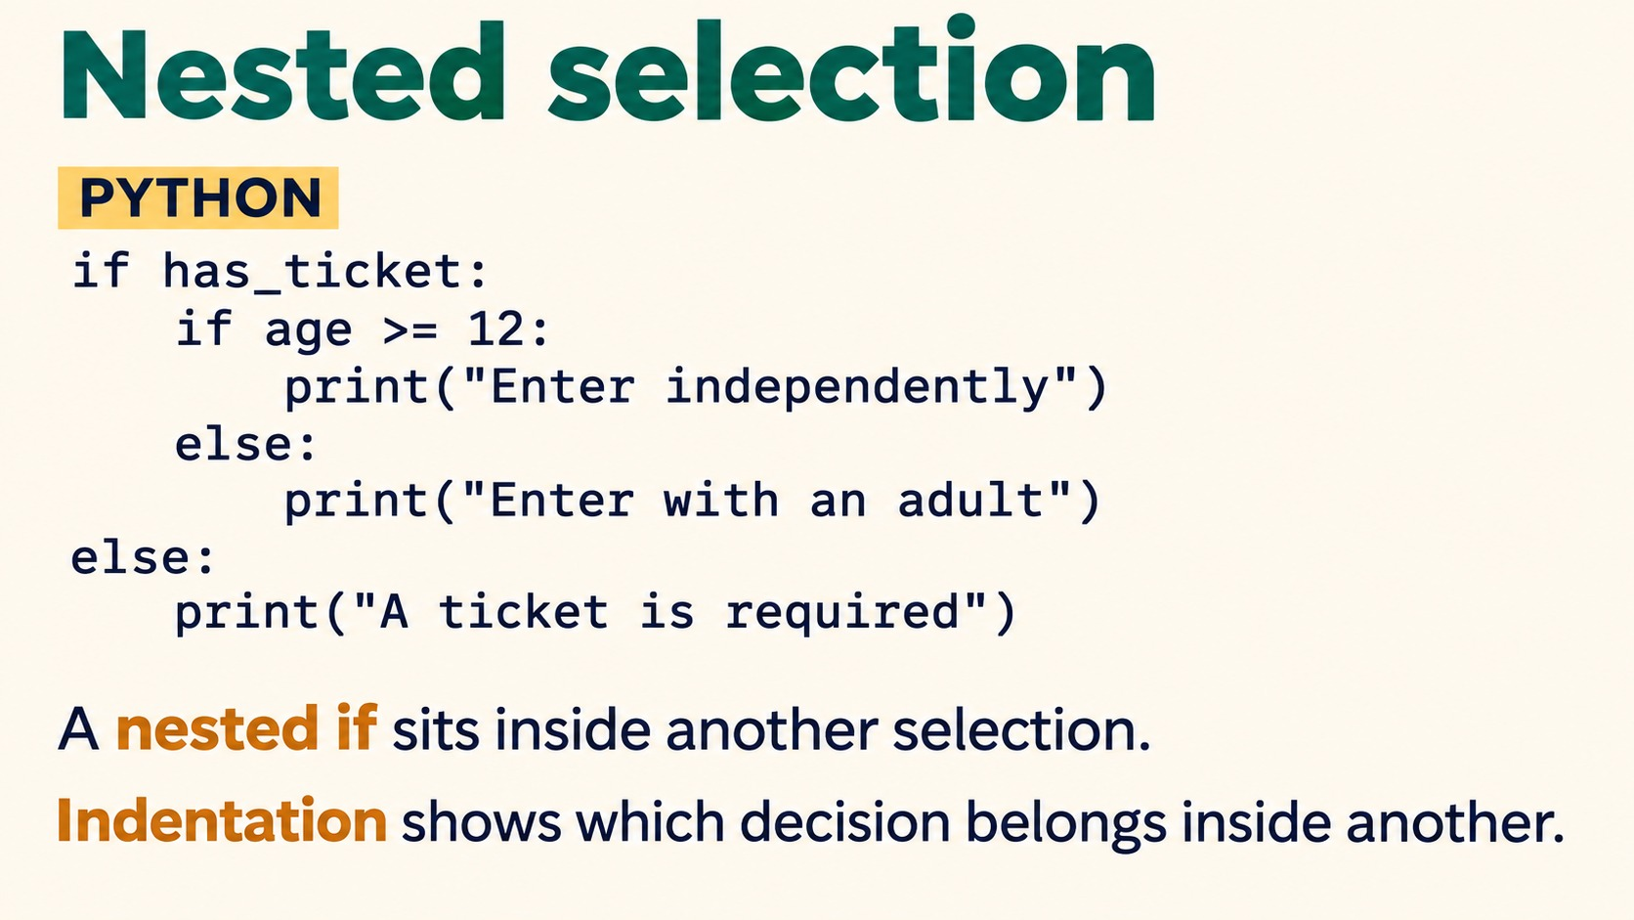
Notes:
Nested selection
PYTHON
if has_ticket:
if age >= 12:
print("Enter independently")
else:
print("Enter with an adult")
else:
print("A ticket is required")
A nested if sits inside another selection.
Indentation shows which decision belongs inside another.
Assume has_ticket is Boolean and age is an integer. Pearson Edexcel pseudocode uses nested IF for additional alternatives.
Source: Pearson Edexcel International GCSE (9-1) Computer Science, Unit 2, Develop Code, printed pages 38-42. Teaching examples adapted for Python. Slide artwork generated with OpenAI image generation.

Slide 16
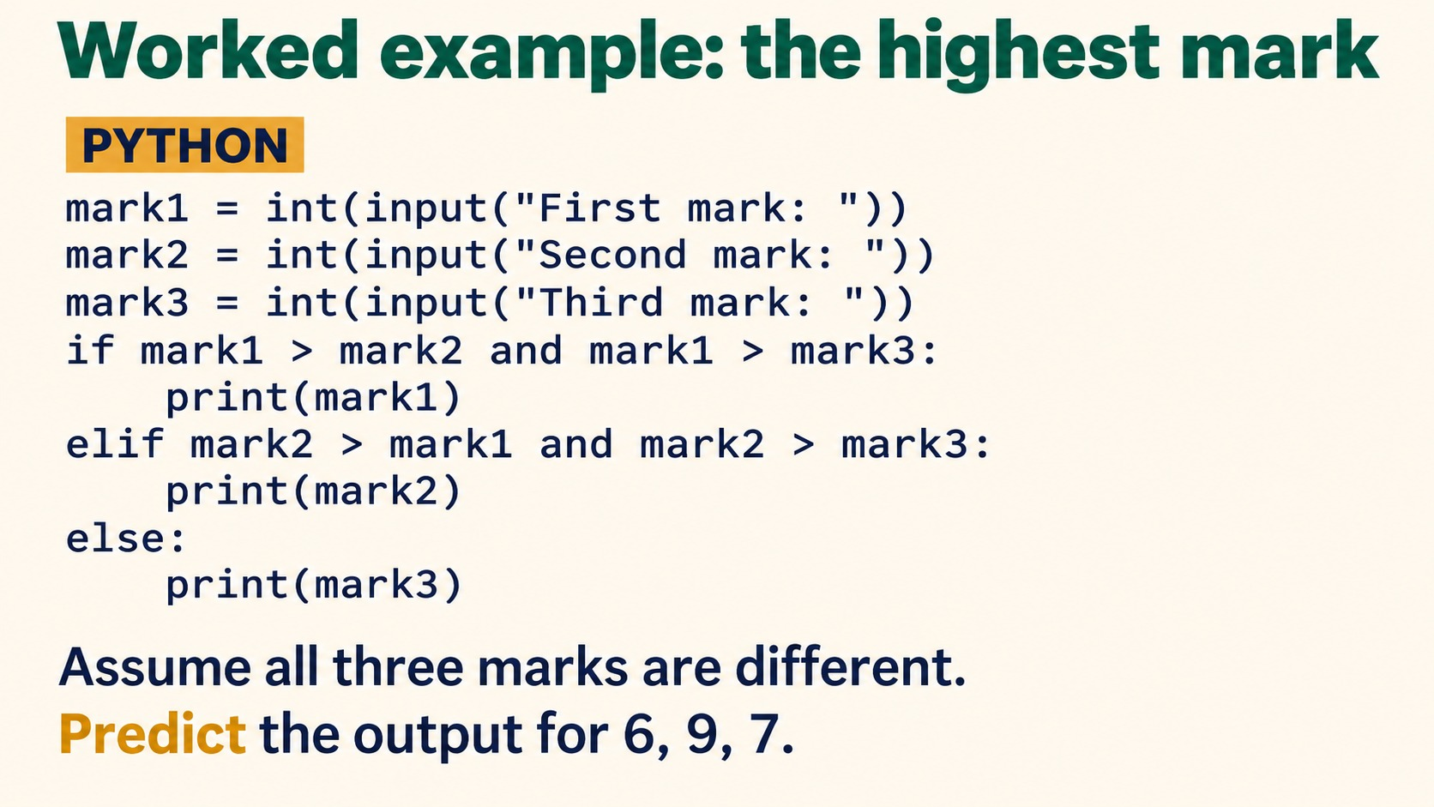
Notes:
Worked example: the highest mark
PYTHON
mark1 = int(input("First mark: "))
mark2 = int(input("Second mark: "))
mark3 = int(input("Third mark: "))
if mark1 > mark2 and mark1 > mark3:
print(mark1)
elif mark2 > mark1 and mark2 > mark3:
print(mark2)
else:
print(mark3)
Assume all three marks are different.
Predict the output for 6, 9, 7.
Answer: 9. Discuss how ties change the assumptions and tests.
Source: Pearson Edexcel International GCSE (9-1) Computer Science, Unit 2, Develop Code, printed pages 38-42. Teaching examples adapted for Python. Slide artwork generated with OpenAI image generation.

Slide 17
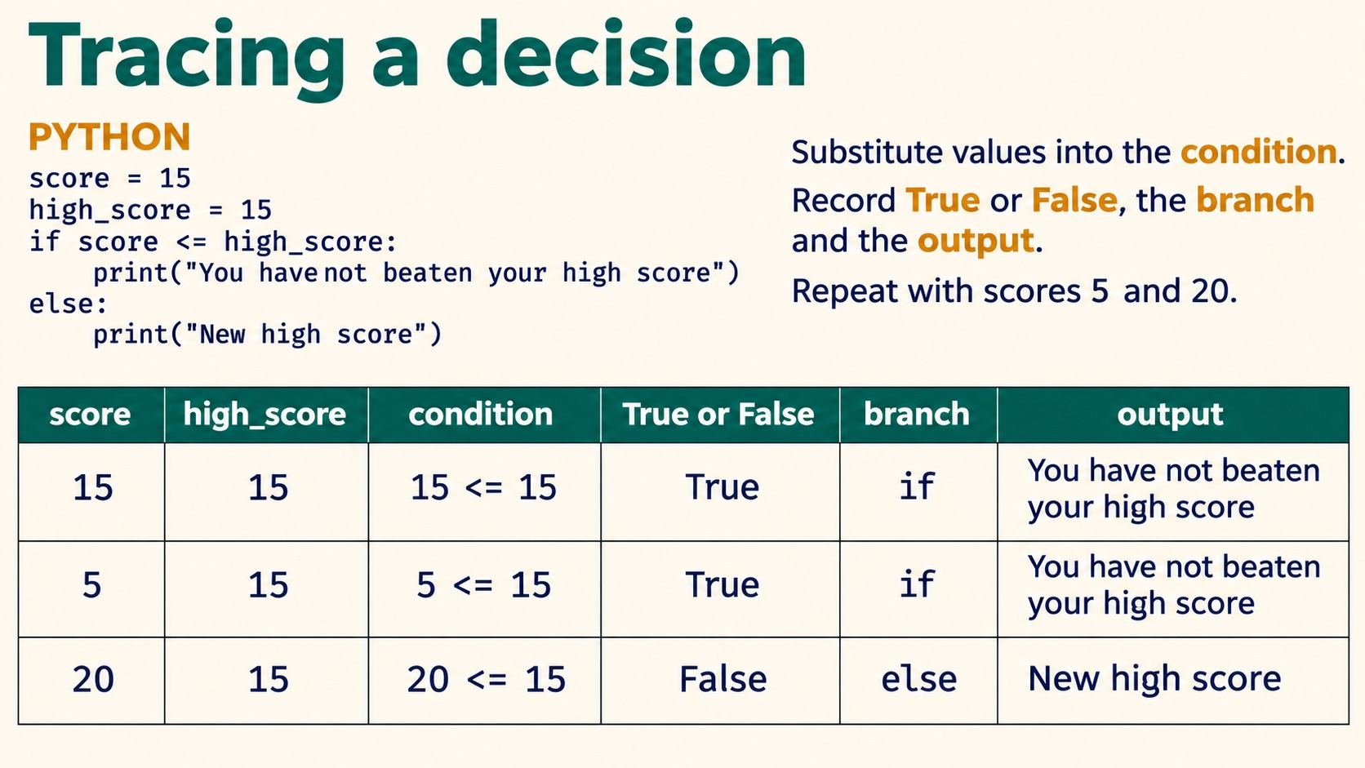
Notes:
Tracing a decision
PYTHON
score = 15
high_score = 15
if score <= high_score:
print("You have not beaten your high score")
else:
print("New high score")
Substitute values into the condition.
Record True or False, the branch and the output.
Repeat with scores 5 and 20.
15 and 5 take the first branch. 20 takes the else branch.
Source: Pearson Edexcel International GCSE (9-1) Computer Science, Unit 2, Develop Code, printed pages 38-42. Teaching examples adapted for Python. Slide artwork generated with OpenAI image generation.

Slide 18
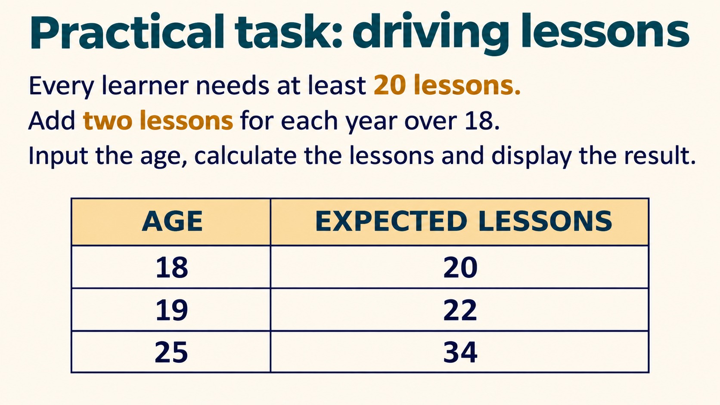
Notes:
Practical task: driving lessons
Every learner needs at least 20 lessons.
Add two lessons for each year over 18.
Input the age, calculate the lessons and display the result.
AGE EXPECTED LESSONS
18 20
19 22
25 34
Solution: lessons = 20; if age > 18: lessons = lessons + (age - 18) * 2. Use age 17 as an additional test.
Source: Pearson Edexcel International GCSE (9-1) Computer Science, Unit 2, Develop Code, printed pages 38-42. Teaching examples adapted for Python. Slide artwork generated with OpenAI image generation.

Slide 19
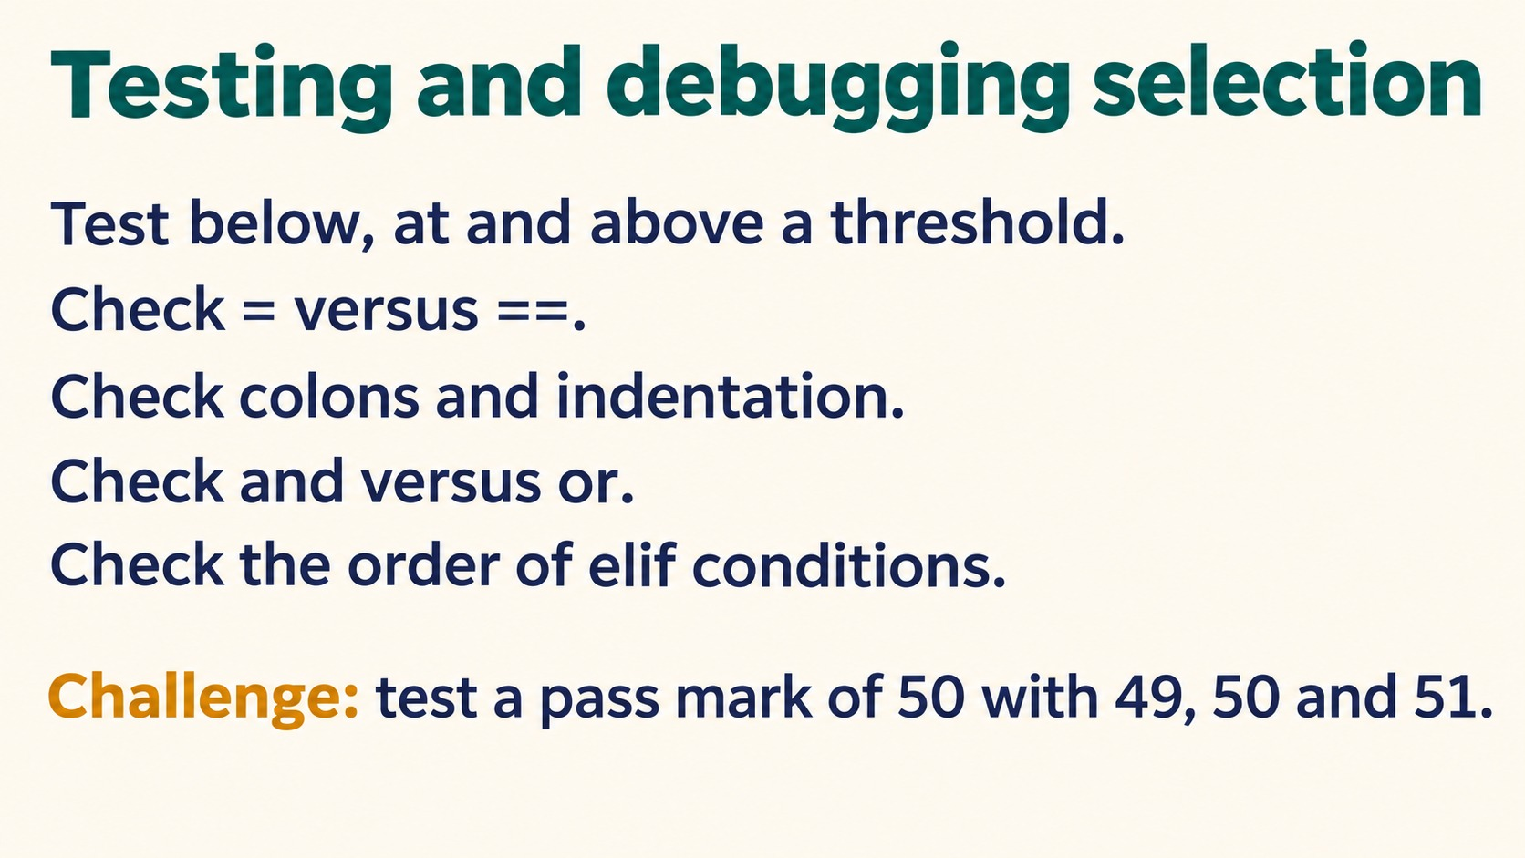
Notes:
Testing and debugging selection
Test below, at and above a threshold.
Check = versus ==.
Check colons and indentation.
Check and versus or.
Check the order of elif conditions.
Challenge: test a pass mark of 50 with 49, 50 and 51.
Source: Pearson Edexcel International GCSE (9-1) Computer Science, Unit 2, Develop Code, printed pages 38-42. Teaching examples adapted for Python. Slide artwork generated with OpenAI image generation.

Slide 20
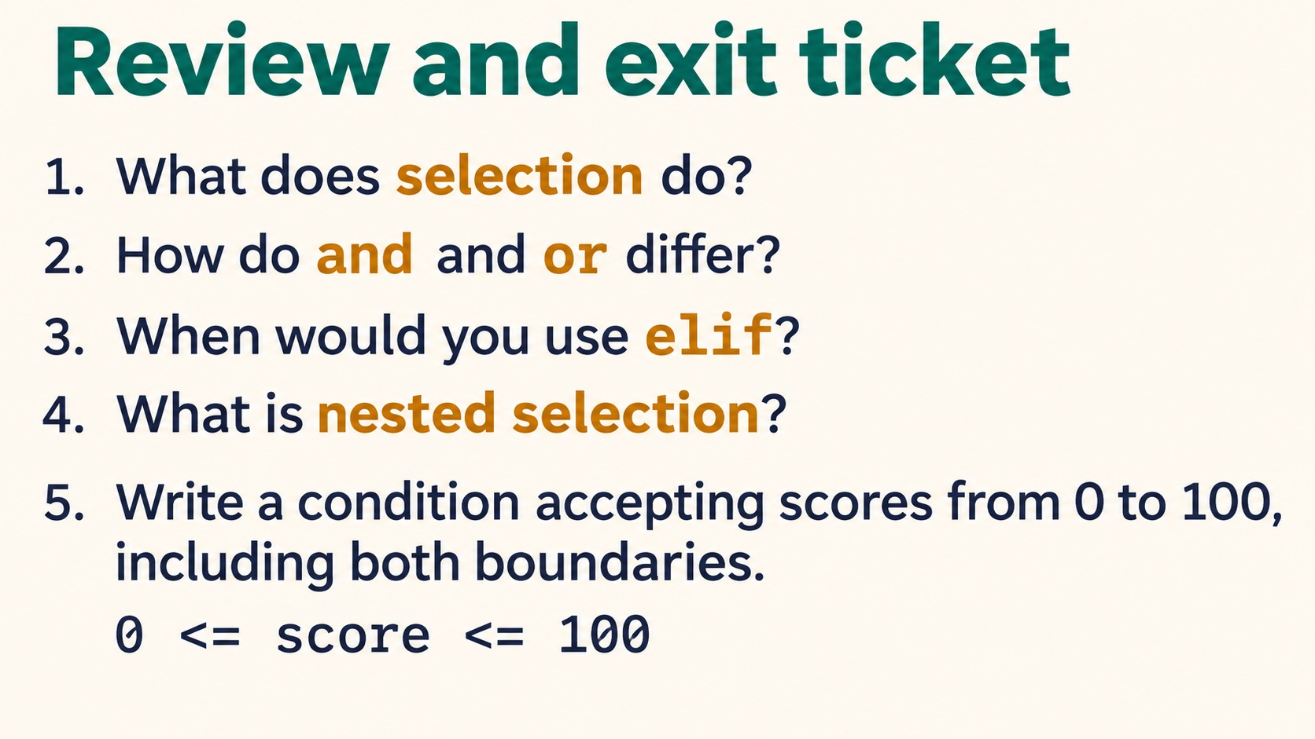
Notes:
Review and exit ticket
What does selection do?
How do and and or differ?
When would you use elif?
What is nested selection?
Write a condition accepting scores from 0 to 100, including both boundaries.
Answer: score >= 0 and score <= 100. Python also supports 0 <= score <= 100.
Source: Pearson Edexcel International GCSE (9-1) Computer Science, Unit 2, Develop Code, printed pages 38-42. Teaching examples adapted for Python. Slide artwork generated with OpenAI image generation.

